Slide 1
AI VILLAGE
Exploring AI interactions and dynamics in a simulated village
GROUP 1
311 - Advaith Arvind
320 - Arjun G Ravi
329 - Govind Sarath
Project guide: Dr. Subu Surendran

Slide 2
CONTENTS
Aim
Introduction
Design
Methodology
Desired Impact
Literature Survey
Conclusion
Reference

Slide 3
AIM
The aim of this project is to explore and analyze the behaviors, interactions, and emerging relationship dynamics among artificial intelligence (AI) agents within a simulated village environment. We also aim to learn about human societies through observing and analyzing AI agent interactions.

Slide 4
INTRODUCTION
Our goal involves crafting a virtual village using Pygame, placing full authority in the hands of autonomous AI agents. The agents will be able manipulate the world around it, which will inturn affect other AI agents. We intend to create a village where the AI agents coexist. We also intend to constantly monitor the relationship between the AI agents.

Slide 5
DESIGN
Design a richly interactive virtual village utilizing Pygame
Empower AI agents to independently manage and modify their surroundings
Encourage AI agents to cooperatively inhabit shared spaces
Continually monitor and assess ‘relationship’ amongst AI agents and the ‘energy level’ of the agents

Slide 6
PEAS Analysis
Performance: The 'energy' value for each AI agent. The 'resources' collected by each AI agent.
Environment: The environment is the village simulated using pygame.
Actuators: The environment is affected by the output of each (LLM) AI agent.
Sensors: The prompt received by each LLM, acts as the sensor to observe the environment.

Slide 7
METHODOLOGY
A harmonious world where all AI agents interact with each other.
We introduce a limited resource, and incentivise the agents to collect the resources.
We create an election, where each AI agents try to impress other, to gain political support
We add a killer into the village. This might adversely affect the relationship between the agents
We introduce further chaos into the village, in the attempt to create further interesting observations

Slide 8
DESIRED IMPACTS
Generate novel insights into AI behavior and social dynamics
Advocate for conscientious AI deployment and collaboration
Highlight pressing ethical concerns surrounding AI behavior and autonomy
Uncover previously unidentified patterns and tendencies in AI interactions
Validate existing theories related to multi-agent coordination and cooperation
Study human societies through observing and analyzing AI agent interactions.

Slide 9
LITERATURE SURVEY
The primary research papers that aided the project are
Generative Agents: Interactive Simulacra of Human Behavior
Inner Monologue: Embodied Reasoning through Planning with Language models
Improving Factuality and Reasoning in Models through Multiagent Debate
Character-LLM: A Trainable Agent for Role-Playing
Chain of Thought Prompting Elicits Reasoning in Large Language
AI-Based Conversational Agents: A Scoping Review From Technologies to Future Directions

Slide 10
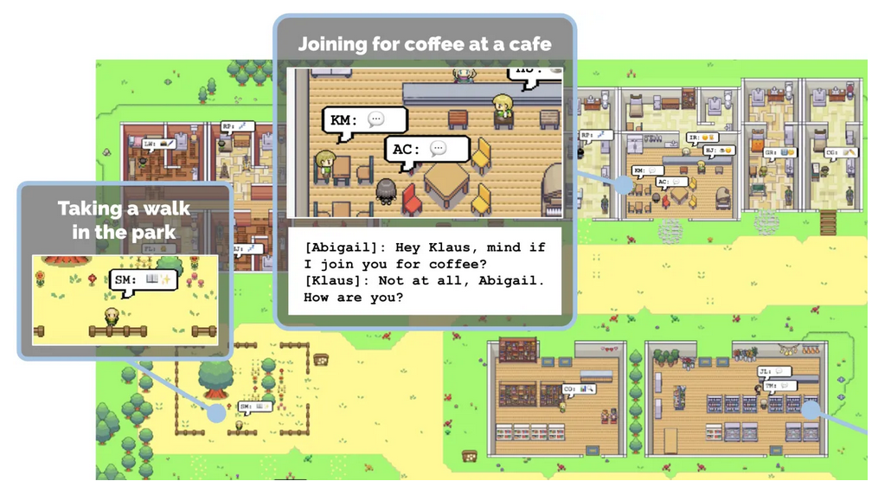
Generative Agents: Interactive Simulacra of Human Behavior
This is the primary paper that introduced the idea of AI agent simulation with large language models.
The paper creates a virtual AI village where AI agents live together in harmony.
The paper talks about how the AI agents are able to organise a party, by communicating with fellow agents.

Slide 11
2. Inner Monologue: Embodied Reasoning through Planning with Language models
This paper focuses on giving LLMs an ‘Inner Monologue’.
It is to investigate to what extent LLMs used in embodied contexts can reason over sources of feedback provided through natural language when additional training is not provided.
The inner monologue allows the LLMs to more richly process and plan robotic control scenarios.

Slide 12
3. Improving Factuality and Reasoning in Models through Multiagent Debate
This paper presents a complementary approach to improve language responses where multiple language model instances propose and debate their individual responses and reasoning processes over multiple rounds to arrive at a common final answer.
The findings indicate that this approach significantly enhances mathematical and strategic reasoning across a number of tasks.

Slide 13
4. Character-LLM: A Trainable Agent for Role-Playing
The paper addresses an intriguing subject of how characters can be simulated using LMs.
The authors devise a novel methodology and playground for making progress on this that allows them to train agents that they then evaluate for their memories/experiences.
The paper creates a new LLM (Character LLM) which is fine tuned to behave just like a human being.

Slide 14
5. Chain of Thought Prompting Elicits Reasoning in Large Language
Chain of thought prompting enables models to generate intermediate reasoning steps to help solve multi-step arithmetic, commonsense, and symbolic reasoning tasks.
It shows us how much simple logical analysis of LLMs can make to the output.
We are planning to implement such a chain of thought prompting into our AI agents.

Slide 15
6. AI-Based Conversational Agents: A Scoping Review From Technologies to Future Directions
This paper studies the impact of artificial intelligence on human-machine interaction, particularly through conversational AI driven by machine learning, deep learning, and natural language processing.
Furthermore, modern conversational agents are designed to simulate human behavior by incorporating emotional, sentimental, and affective nuances.

Slide 16
CONCLUSION
To conclude, our AI Village project demonstrates great promise in advancing understanding of AI behavior and social dynamics within intricate environments. Its emphasis on responsible AI integration, collaborative coexistence, and continuous relationship assessment offers unique opportunities for exploring novel implications and consequences arising from AI presence among us. Ultimately, we hope to inspire informed discussions regarding AI ethics, governance, and societal impact.

Slide 17
REFERENCES
[1] Joon Sung Park, Joseph C. O’Brien, Carrie J. Cai, Meredith Ringel Morris, Percy Liang, and Michael S. Bernstein. 2023. Generative Agents: Interactive Simulacra of Human Behavior. In ACM, New York, NY, USA.
[2] Huang, W., Xia, F., Xiao, T., Chan, H., Liang, J., Florence, P.R., Zeng, A., Tompson, J., Mordatch, I., Chebotar, Y., Sermanet, P., Brown, N., Jackson, T., Luu, L., Levine, S., Hausman, K., & Ichter, B. (2022). Inner Monologue: Embodied Reasoning through Planning with Language Models. Conference on Robot Learning.
[3] Mialon, G., Dessì, R., Lomeli, M., Nalmpantis, C., Pasunuru, R., Raileanu, R.,Rozière, B., Schick, T., Dwivedi-Yu, J., Celikyilmaz, A., Grave, E., LeCun, Y., & Scialom, T. (2023). Augmented Language Models: a Survey. ArXiv, abs/2302.07842.
[4] Park, J.S., Popowski, L., Cai, C.J., Morris, M.R., Liang, P., & Bernstein, M.S. (2022). Social Simulacra: Creating Populated Prototypes for Social Computing Systems. Proceedings of the 35th Annual ACM Symposium on User Interface Software and Technology.

Slide 18
[5] Wang, L., Ma, C., Feng, X., Zhang, Z., Yang, H., Zhang, J., Chen, Z., Tang, J.,Chen, X., Lin, Y., Zhao, W.X., Wei, Z., & Wen, J. (2023). A Survey on Large Language Model based Autonomous Agents. ArXiv, abs/2308.11432.
[6] Yao, S., Zhao, J., Yu, D., Du, N., Shafran, I., Narasimhan, K., & Cao, Y. (2022).ReAct: Synergizing Reasoning and Acting in language Models. ArXiv,abs/2210.03629.
[7] Anil, Gemini Team Google Rohan et al. “Gemini: A Family of Highly Capable Multimodal Models.” ArXiv abs/2312.11805 (2023): n. pag.
[8] Yao, S., Yu, D., Zhao, J., Shafran, I., Griffiths, T.L., Cao, Y., & Narasimhan, K. (2023). Tree of Thoughts: Deliberate Problem Solving with Large Language Models. ArXiv, abs/2305.10601.
[9] Wei, J., Wang, X., Schuurmans, D., Bosma, M., Chi, E.H., Xia, F., Le, Q., & Zhou, D. (2022). Chain of Thought Prompting Elicits Reasoning in Large Language Models. ArXiv, abs/2201.11903.
[10] Shao, Y., Li, L., Dai, J., & Qiu, X. (2023). Character-LLM: A Trainable Agent for Role-Playing. ArXiv, abs/2310.10158.

Slide 19
[11] Du, Y., Li, S., Torralba, A., Tenenbaum, J.B., & Mordatch, I. (2023). Improving Factuality and Reasoning in Language Models through Multiagent Debate. ArXiv, abs/2305.14325. [12] S. Kusal, S. Patil, J. Choudrie, K. Kotecha, S. Mishra and A. Abraham, "AI-Based Conversational Agents: A Scoping Review From Technologies to Future directions," in IEEE Access, vol. 10, pp. 92337-92356, 2022, doi: 10.1109/ACCESS.2022.3201144.

Slide 20
Thank you

